Slide 1
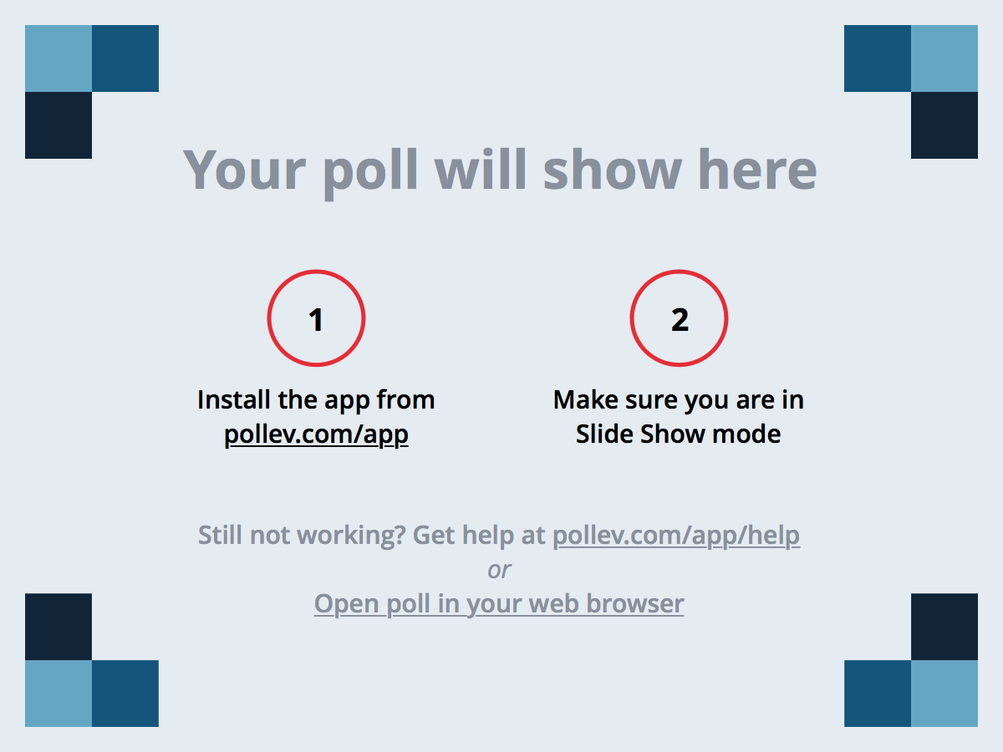
Notes:
Poll Title: How's the homework going so far? https://www.polleverywhere.com/multiple_choice_polls/dEJChfyJT1iMibD

Slide 2

Homework Assignment
Also, at this point everyone should have access to the homework repository in GitHub. https://github.com/RutgersCodingBootcamp/All-Classwork-Homework
Homework Assignment #1 is Due: MW Class - Monday (2/1/16) TTH Class – Tuesday (2/2/16)
© 2016 | RCB - All Rights Reserved
© 2016 | Rutgers Coding Bootcamp - All Rights Reserved

Slide 3
Advice for this Assignment…
Really, work hard on this assignment! This assignment introduces you to fundamental concepts that we’ll be building the entire course-long.
Review In Class Material especially Exercises: https://github.com/RutgersCodingBootcamp/0125-mw-class-content
Work with your peers! It’s much better than screaming at your computer alone.
Ask Questions on Slack! Your peers, TAs, and Instructors are all here to help when they can.
© 2016 | RCB - All Rights Reserved
© 2016 | Rutgers Coding Bootcamp - All Rights Reserved

Slide 4

Heroes of CSS
Day 3
Rutgers Coding Bootcamp | January 29, 2016
© 2016 | RCB - All Rights Reserved
Notes:
Start at 6:45 PM

Slide 5
CSS Stylin’
© 2016 | RCB - All Rights Reserved
Notes:
7:00 – 7:05

Slide 6


HTML / CSS Definitions (*yawn* unimportant)
HTML: Hypertext Markup Language – (Content)
CSS: Cascading Style Sheets – (Appearance)
HTML/CSS are the “languages of the web”. Together they define both the content and the aesthetics of a webpage – handling everything from the layouts, colors, fonts, and content placement. (Javascript is the third – handling logic, animation, etc.)
© 2016 | RCB - All Rights Reserved
© 2016 | Rutgers Coding Bootcamp - All Rights Reserved

Slide 7


HTML vs HTML/CSS
HTML Alone
Like writing papers in “Notepad”.
Can only write unformatted text.
HTML / CSS
Like writing papers in Microsoft Word.
Can format text, page settings, alignment, etc. based on “highlighting” and menu options.
© 2016 | RCB - All Rights Reserved
© 2016 | Rutgers Coding Bootcamp - All Rights Reserved

Slide 8
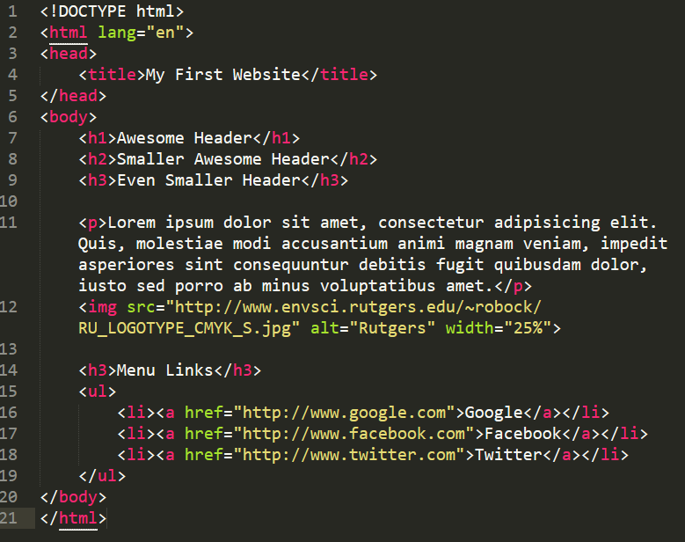
Basic HTML Page
© 2016 | RCB - All Rights Reserved
© 2016 | Rutgers Coding Bootcamp - All Rights Reserved

Slide 9
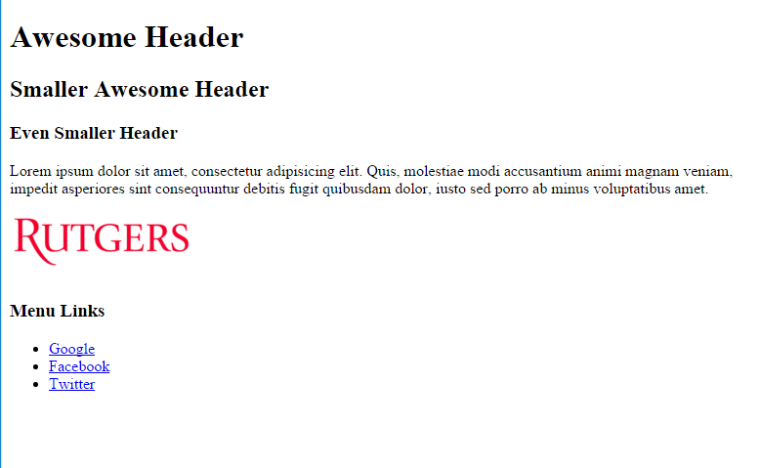
Basic HTML Page
© 2016 | RCB - All Rights Reserved
© 2016 | Rutgers Coding Bootcamp - All Rights Reserved

Slide 10
Basic HTML Page
Hella Boring…
© 2016 | RCB - All Rights Reserved
© 2016 | Rutgers Coding Bootcamp - All Rights Reserved

Slide 11
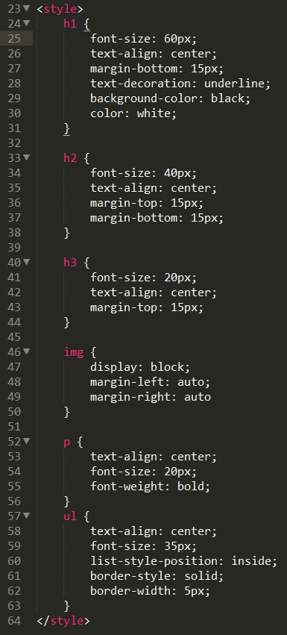
Enter CSS
© 2016 | RCB - All Rights Reserved
© 2016 | Rutgers Coding Bootcamp - All Rights Reserved

Slide 12
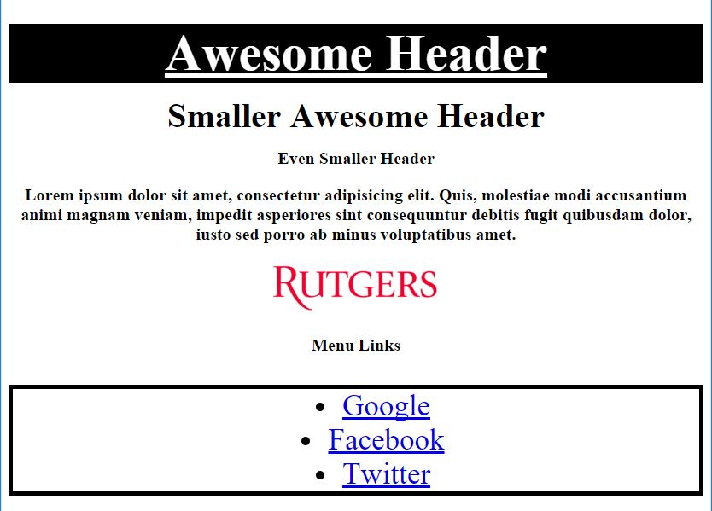
Enter CSS
© 2016 | RCB - All Rights Reserved
© 2016 | Rutgers Coding Bootcamp - All Rights Reserved

Slide 13

CSS Syntax
CSS works by hooking onto selectors added into HTML using “classes and identifiers”.
Once hooked, we apply styles to those HTML elements using css .
© 2016 | RCB - All Rights Reserved
© 2016 | Rutgers Coding Bootcamp - All Rights Reserved

Slide 14
CSS Example
In the below example the “Header” would be turned blue and MUCH larger, because of the CSS.
If we’d like to apply a CSS style selectively, we can incorporate a class or ID. Just remember to include the necessary symbol (. or #) before the css.
Example (HTML):
<p class=“bigBlue”>Header</p>
Example (CSS):
.bigBlue
{
font-size: 100px;
color: blue;s
}
© 2016 | RCB - All Rights Reserved
© 2016 | Rutgers Coding Bootcamp - All Rights Reserved

Slide 15
Key CSS Attributes
Font / Color:
color: Sets color of text
font-size: Sets size of the font
font-style: Sets italics
font-weight: Sets bold
Alignment / Spacing:
margin-top(bottom/left/right): Adds space between element and its own border.
margin-top (bottom/left/right): Adds space between element and surrounding elements.
float: Forces elements to the sides, centers, or tops
Background:
background-color: sets background color
background-image: sets background image
© 2016 | RCB - All Rights Reserved
© 2016 | Rutgers Coding Bootcamp - All Rights Reserved

Slide 16
Powerful Duo
Believe it or not… HTML / CSS is all you need to develop a full-blown rich looking website.
© 2016 | RCB - All Rights Reserved
© 2016 | Rutgers Coding Bootcamp - All Rights Reserved

Slide 17
CSS Show!
© 2016 | RCB - All Rights Reserved
Notes:
7:00 – 7:05

Slide 18
> YOUR TURN!!
Assignment
In this activity, you’ll be upgrading your previous HTML bio using CSS styles. Once you are done with your changes, you’ll commit and push these changes up to GitHub.
Additional instructions, sent via Slack.
© 2016 | RCB - All Rights Reserved
Notes:
Send snapshot from Git command line

Slide 19
CSS Resets
© 2016 | RCB - All Rights Reserved
Notes:
7:00 – 7:05

Slide 20

Loading Multiple CSS Files ***(Very Important!!!)***
One of the most powerful aspects of CSS is the ability to deploy multiple CSS files simultaneously.
This allows developers the ability to create complex designs – made up of multiple design elements.
Just remember the loading order matters!!!
© 2016 | RCB - All Rights Reserved
Notes:
7:00 – 7:05

Slide 21
Notes:
Poll Title: Which Internet Browser do you use? https://www.polleverywhere.com/multiple_choice_polls/J1Gsu4Ct1RzO4lC

Slide 22

Battle of the Browsers
Under-the hood there are often significant differences between how browsers render webpages.
These differences in rendering agents can mean HTML/CSS gets displayed differently in each.
As designers/developers, creating cross-browser compatible websites is critical.
© 2016 | RCB - All Rights Reserved
Notes:
7:00 – 7:05

Slide 23

Reset.css (or Normalize.css)
Reset.css ensures that all browser-specific css has been reset, so it appears the same in all browsers.
This means you will have to re-style everything yourself
© 2016 | RCB - All Rights Reserved
Notes:
7:00 – 7:05

Slide 24
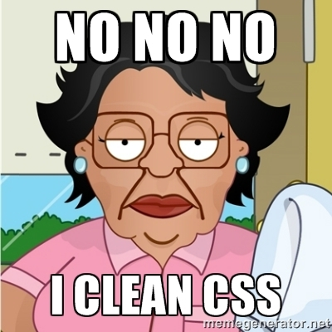
Why CSS Resets Matter
It’s important for creating browser-compatible websites
It’s an example of using someone else’s CSS in your website!!!
It’s a common Front-End Developer Interview question.
© 2016 | RCB - All Rights Reserved
Notes:
7:00 – 7:05

Slide 25
We be Floatin’
© 2016 | RCB - All Rights Reserved
Notes:
7:00 – 7:05

Slide 26

Take a Facebook Break…
Warning!
This is a fairly “tricky”… but VERY IMPORTANT topic.
Time to channel that inner genius.
© 2016 | RCB - All Rights Reserved
Notes:
7:00 – 7:05

Slide 27

The Concept of “Flow”
In HTML/CSS, (by default) every element displayed is governed by a concept called “flow”.
This means that HTML elements force their adjacent elements to flow around them.
© 2016 | RCB - All Rights Reserved
Notes:
7:00 – 7:05

Slide 28
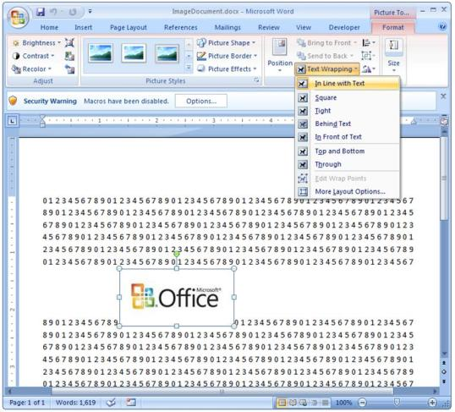
Flow Analogy to MS Word
This concept of “flow” is very similar to the wrap-text options you may be familiar with in Microsoft Word.
Just as in MS Word, you can have images in-line with text, on-top of text, etc.
© 2016 | RCB - All Rights Reserved
Notes:
7:00 – 7:05

Slide 29
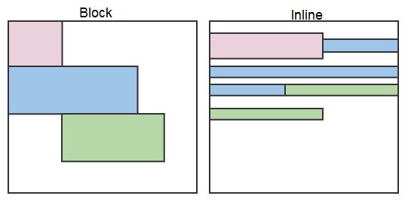
Block Elements
By default, many HTML elements (paragraphs, headers, div, etc..) are treated as block elements.
This means, they take up an entire line of space, unless you intervene with CSS properties.
© 2016 | RCB - All Rights Reserved
Notes:
7:00 – 7:05

Slide 30
Block Elements vs. Inline Elements
Now… contrast the block elements with inline elements.
By using float CSS properties, we can command our website to display multiple CSS elements adjacently.
© 2016 | RCB - All Rights Reserved
Notes:
7:00 – 7:05

Slide 31
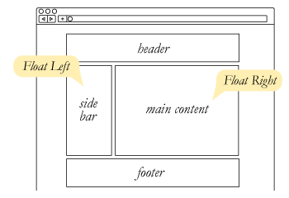
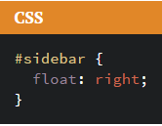
Floating
In order to convert these block elements into inline elements, we utilize a CSS property called float.
Floats are necessary for building web layouts
© 2016 | RCB - All Rights Reserved
Notes:
7:00 – 7:05

Slide 32
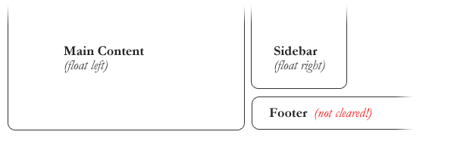
Clearing the Float
Sometimes… floats get in the way, and elements that we don’t want to be “in-line” are treated as such.
© 2016 | RCB - All Rights Reserved
Notes:
7:00 – 7:05

Slide 33
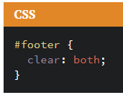
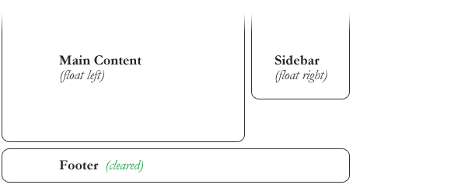
Clearing the Float
We use the CSS property clear to re-force elements to behave as block elements or to avoid being pulled in by a float.
© 2016 | RCB - All Rights Reserved
Notes:
7:00 – 7:05

Slide 34
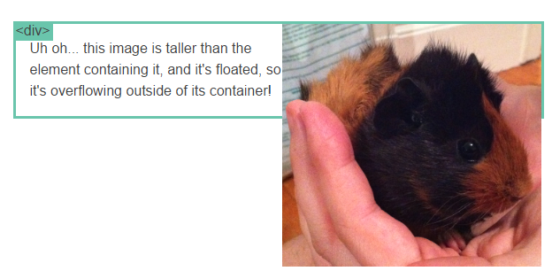
Clearfix Hack
Sometimes when elements don’t match up in size, we get situations like the above…
© 2016 | RCB - All Rights Reserved
Notes:
7:00 – 7:05

Slide 35
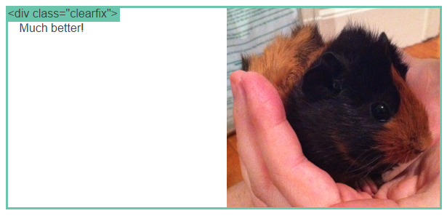
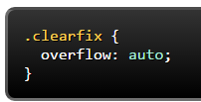
Clearfix Hack
We can get around it by using what’s called the “clearfix hack”. By using the CSS property overflow: auto, the first element will fill up the empty parts of the flow.
© 2016 | RCB - All Rights Reserved
Notes:
7:00 – 7:05

Slide 36
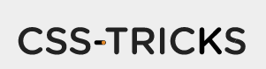
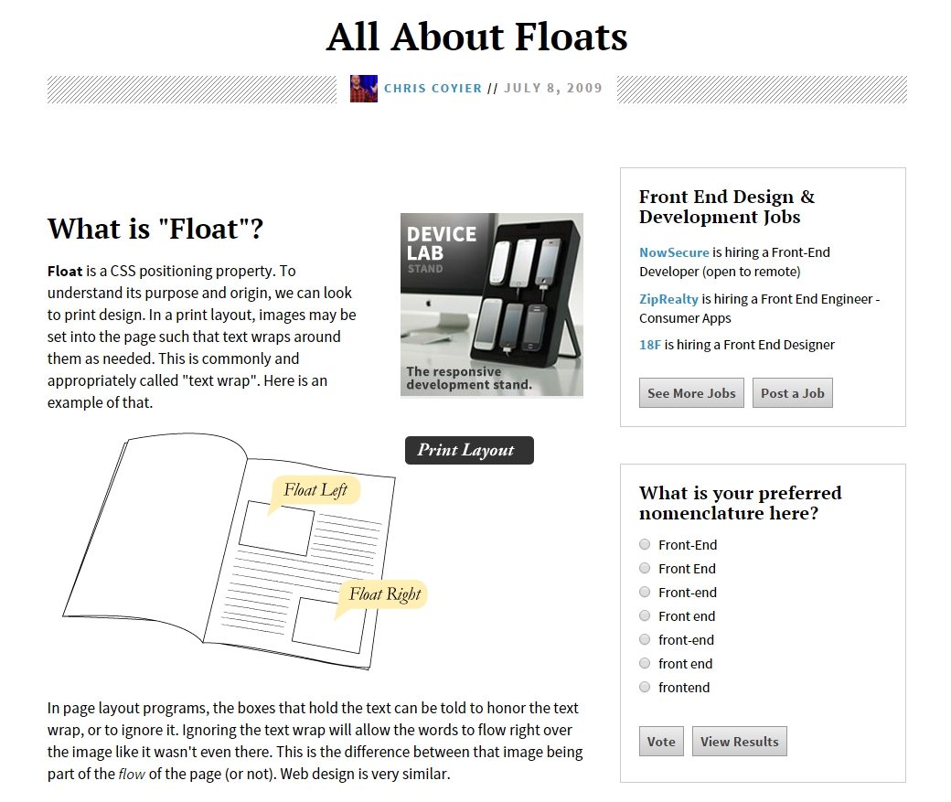
Fantastic Guide on Floats ****
To all serious front-end developers (this is a necessary read): https://css-tricks.com/all-about-floats/
© 2016 | RCB - All Rights Reserved
Notes:
7:00 – 7:05

Slide 37
> YOUR TURN!!
Assignment
In this activity, you will be flexing your newfound floating skills to create a conceptual layout. Eyeball the design to your best ability.
Additional instructions, sent via Slack.
© 2016 | RCB - All Rights Reserved
Notes:
Send snapshot from Git command line

Slide 38
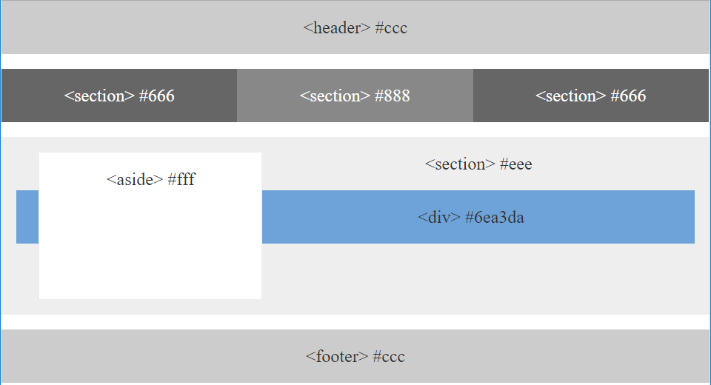
> YOUR TURN!!
© 2016 | RCB - All Rights Reserved
Notes:
Send snapshot from Git command line

Slide 39

Good work!
Your Brain may rest now
© 2016 | RCB - All Rights Reserved
Notes:
7:00 – 7:05

Slide 40
Lunch Break!
© 2016 | RCB - All Rights Reserved
Notes:
7:00 – 7:05

Slide 41
Chrome Inspector
© 2016 | RCB - All Rights Reserved
Notes:
15 Minutes

Slide 42

What is Inspector?
A “secret room” for developers within Chrome
Allows you to see what’s going on under the covers of a web page
The best thing to happen to web developers!
© 2016 | RCB - All Rights Reserved
Notes:
7:00 – 7:05

Slide 43

What is Inspector?
Full of good things
Focus today is on “Elements”
Elements lets you
Examine your HTML
Tweak your HTML and test changes
© 2016 | RCB - All Rights Reserved
Notes:
7:00 – 7:05

Slide 44

What is Inspector?
The right panel contains CSS information
Styles
Shows all CSS styles which affect an element
Edit the CSS and see what change would happen
Computed
Shows the “sum total” of all the styling affecting an element
© 2016 | RCB - All Rights Reserved
Notes:
15 Minutes

Slide 45
Watch Me!
Changing the Student Bio on the fly
Using the Left (main) panel
Changing “Contact Info” to “Deets”
Using the Right (styles) panel
Change font size of H2 from 24 to 36
Then, I hit “refresh” ☹
© 2016 | RCB - All Rights Reserved
Notes:
7:00 – 7:05

Slide 46
Your Turn! (10 Minutes)
Highlight the `<div class="container">` element in the Elements panel
In the Styles side panel, change the width from `1024px` to `600px`
What happens?
In the Elements panel, highlight the `<h1>` tag. Right click and select "Edit Text" OR you can double click on the text to edit it. Change the text to say "My Biography". Press "enter" to finalize your changes or mouse click away.
What happens?
© 2016 | RCB - All Rights Reserved
Notes:
7:00 – 7:05

Slide 47
Bonus Your Turn! (20 Minutes)
Using Inspector, make a new `section` tag with an id of `#new`
Make your new section tag appear just below the #contact-info section
Now make it appear below both #main-bio and #contact-info
Make it have a `background-color` of red
© 2016 | RCB - All Rights Reserved
Notes:
7:00 – 7:05

Slide 48
The Box Model
© 2016 | RCB - All Rights Reserved
Notes:
10 minutes

Slide 49
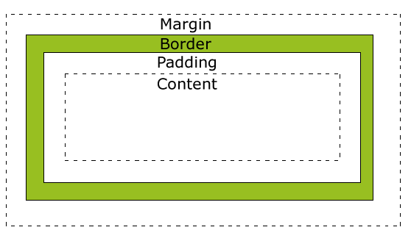
The Box Model
Content - The content of the box, where text and images appear
Padding - Clears an area around the content. The padding is transparent
Border - A border that goes around the padding and content
Margin - Clears an area outside the border. The margin is transparent
© 2016 | RCB - All Rights Reserved
Notes:
7:00 – 7:05

Slide 50
The Box Model
The CSS box model is essentially a box that wraps around every HTML element. It consists of: margins, borders, padding, and the actual content.
Padding, margins, borders
Writing shorthand for margin and padding is clockwise (top, right, bottom, left e.g. `padding: 20px 30px 20px 30px`).
If there are only 3 values, then the last value (left), assumes the same value as the right side.
If there are 2 values, the first two apply to top and bottom, the second two apply to left and right.
If there is only one value, it applies to all sides.
© 2016 | RCB - All Rights Reserved
Notes:
7:00 – 7:05

Slide 51
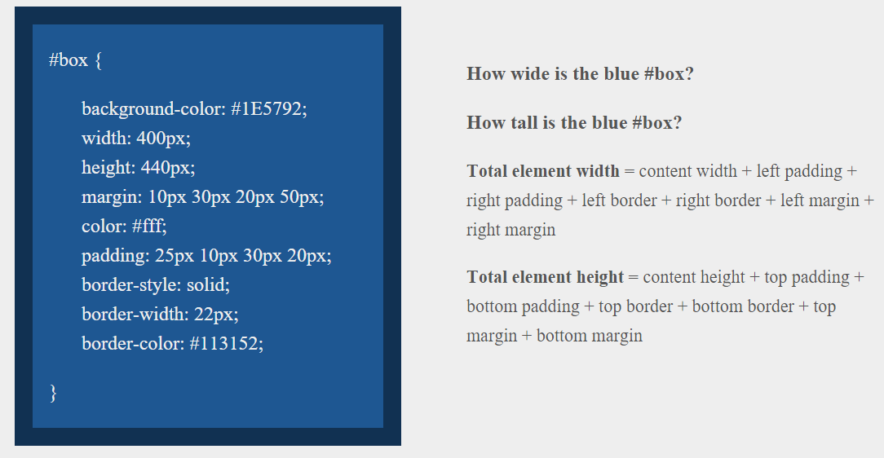
Your Turn! (5 Minutes)
Slack your answer!
© 2016 | RCB - All Rights Reserved
Notes:
7:00 – 7:05

Slide 52
box-sizing: border-box
The use of content, padding, border, and margin to calculate box sizes can be confusing (or counter-intuitive)
If you use box-sizing: border-box
The width and height will include padding and border
Still won’t include margin
© 2016 | RCB - All Rights Reserved
Notes:
7:00 – 7:05

Slide 53
Browser Rendering Engines
Webkit
http://stackoverflow.com/questions/6867254/browsers-default-css-for-html-elements
Firefox
http://mxr.mozilla.org/mozilla-central/source/layout/style/html.css
© 2016 | RCB - All Rights Reserved
Notes:
7:00 – 7:05

Slide 54
CSS Positioning
absolute, relative, fixed, static
`position: static` is the default positioning for every single element. It means the element will flow the way it was intended
`position: relative` can enable and element to be positioned RELATIVE to its original position. You can reposition it using `top: -20px` etc. It will then move -20px upwards
`position: fixed` positions the element relative to the viewport, or browser screen. This means it will remain when scrolling because its position is based on the viewport and not on its surrounding html elements
`position: absolute` positions itself based on the nearest relatively positioned ancestor (meaning the tags it is inside of).
z-index
`display: none ` vs `visibility: hidden`
© 2016 | RCB - All Rights Reserved
Notes:
7:00 – 7:05

Slide 55
CSS Positioning
© 2016 | RCB - All Rights Reserved
Notes:
7:00 – 7:05

Slide 56
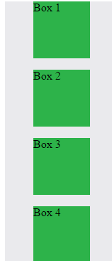
Position: Static (Default)
Four boxes placed statically (default)
© 2016 | RCB - All Rights Reserved
Notes:
7:00 – 7:05

Slide 57
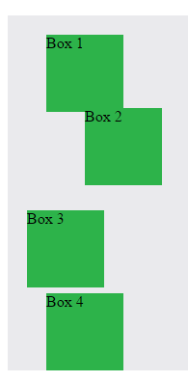

Position: Relative
Switching the boxes to relative nudges the boxes in relation to their “original” location.
© 2016 | RCB - All Rights Reserved
Notes:
7:00 – 7:05

Slide 58
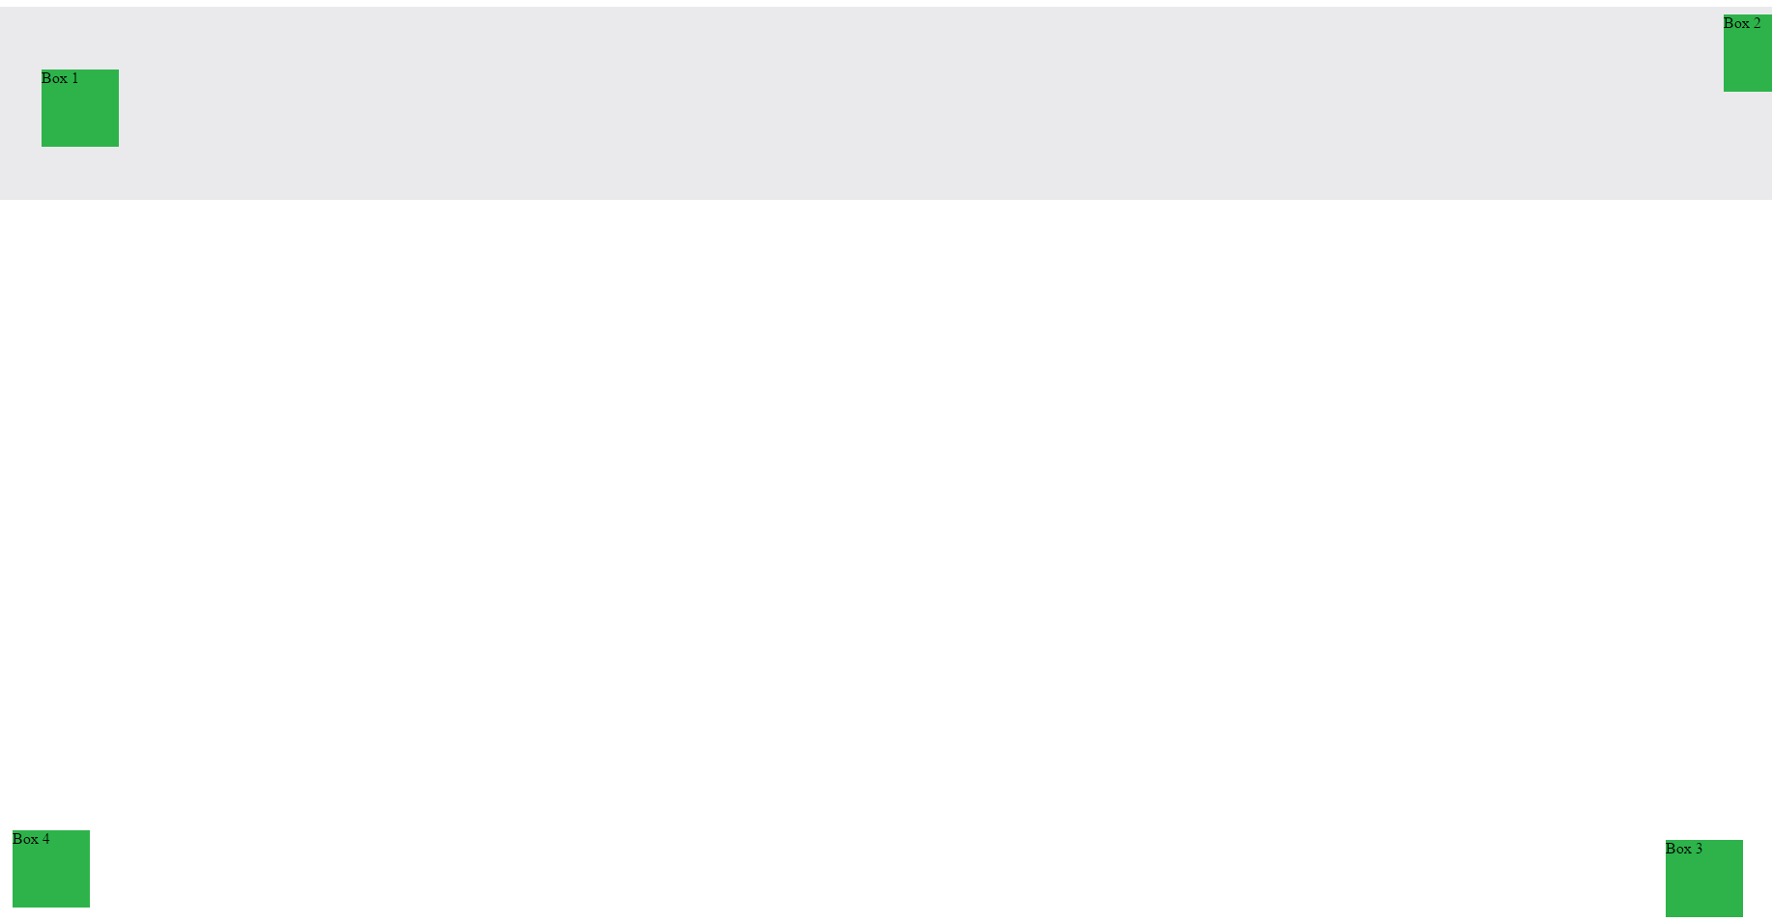
Position: Absolute
Position with location relevant to first “placed” element
© 2016 | RCB - All Rights Reserved
Notes:
7:00 – 7:05

Slide 59

Position: Fixed
Position with exact coordinates to the browser window
© 2016 | RCB - All Rights Reserved
Notes:
7:00 – 7:05

Slide 60
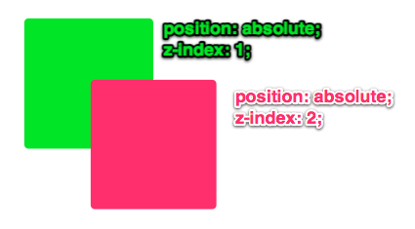
Layering with Z-Index
Z-Index allows you to layer elements on top of each other when placed in absolute coordinates
© 2016 | RCB - All Rights Reserved
Notes:
7:00 – 7:05

Slide 61
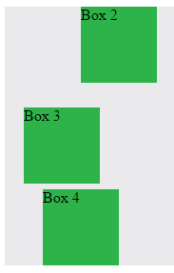
Hiding Things
Display none allows elements to be completely hidden from view.
This becomes useful because in later sections, we will be selectively activating and de-activating.
© 2016 | RCB - All Rights Reserved
Notes:
7:00 – 7:05

Slide 62
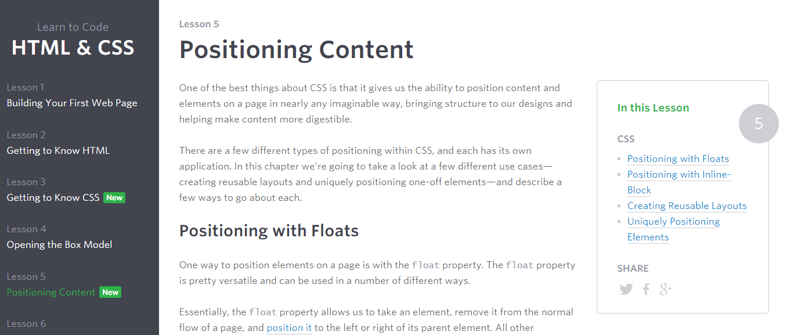
Great Resource
Another great read for front-end developers (and game designers): http://learn.shayhowe.com/html-css/positioning-content/
© 2016 | RCB - All Rights Reserved
Notes:
7:00 – 7:05

Slide 63
> YOUR TURN!!
Assignment
In this activity, you will be flexing your newfound positioning skills to create another conceptual layout. Eyeball the design to your best ability.
Additional instructions, sent via Slack.
© 2016 | RCB - All Rights Reserved
Notes:
Send snapshot from Git command line

Slide 64
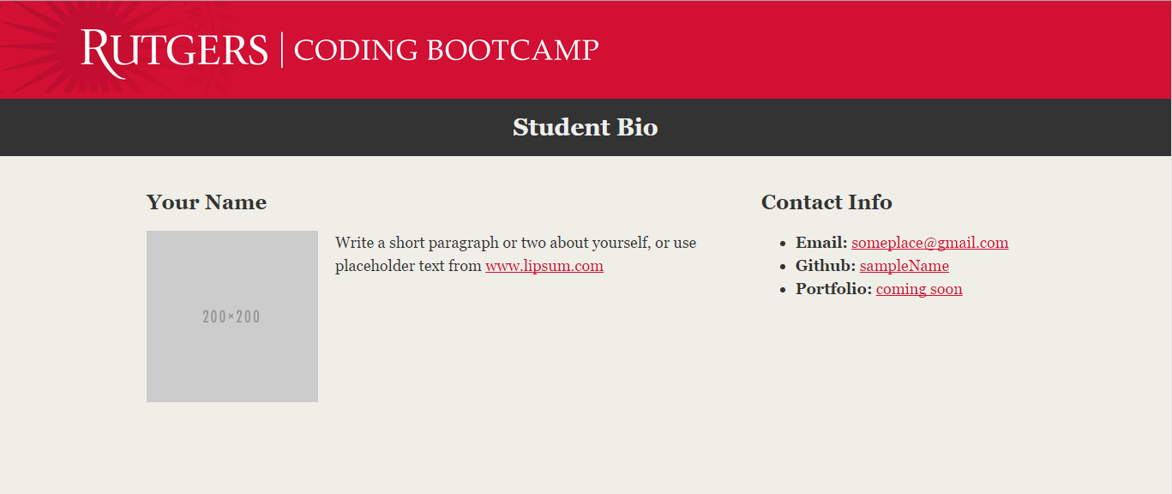
> YOUR TURN!!
© 2016 | RCB - All Rights Reserved
Notes:
Send snapshot from Git command line

Slide 65
> YOUR TURN!!
© 2016 | RCB - All Rights Reserved
Notes:
Send snapshot from Git command line

Slide 66

> YOUR TURN!!
© 2016 | RCB - All Rights Reserved
Notes:
Send snapshot from Git command line

Slide 67
Recap + Questions
© 2016 | RCB - All Rights Reserved
Notes:
7:00 – 7:05

Slide 68
Focus on Layouts + Git + HW
© 2016 | RCB - All Rights Reserved
Notes:
7:00 – 7:05

Slide 69
> YOUR TURN!!
© 2016 | RCB - All Rights Reserved
Notes:
Send snapshot from Git command line

Slide 70
To the Web with Heroku!
© 2016 | RCB - All Rights Reserved
Notes:
7:00 – 7:05

Slide 71

Great Resource on Positioning
To better understand CSS Positioning:
http://www.barelyfitz.com/screencast/html-training/css/positioning/
© 2016 | RCB - All Rights Reserved
Notes:
7:00 – 7:05

Slide 72

Great Resource on Positioning
To better understand CSS Positioning:
http://www.barelyfitz.com/screencast/html-training/css/positioning/
© 2016 | RCB - All Rights Reserved
Notes:
7:00 – 7:05

Slide 73
> YOUR TURN!!
Assignment
Time to take your newfangled website and deploy it to the cloud. Setup your own instance of Heroku and deploy one of your HTML creations to Heroku.
Additional instructions to be sent via Slack.
© 2016 | RCB - All Rights Reserved
Notes:
Send snapshot from Git command line

